Slide 1
Correlates of Nursing Facility Occupancy
Presentation to HCBS Conference Arlington, VA September 18, 2014
Leslie Hendrickson
Hendrickson Development

Slide 2
Purpose
Gain better understanding of factors affecting NF occupancy. Built two models and studied important zero-order correlations.
First model is % Medicaid Occupancy in NFs. The percentage of residents whose stay is paid for by Medicaid.
Second model is nursing facility population as percent of persons aged 75 and older. Why do some states have higher percentages of older persons in NFs?

Slide 3
Data Set
29 variables from AARP Rising Expectations
4 variables from OSCAR data
% Medicaid
% Medicare
% State NF occupancy
Total NF population by state
9 variables from U.S. Census
7 combinations of the above

Slide 4
Take Aways
Six-variable model accounts for 82% of variance in the state NF Medicaid Occupancy %
Four-variable model accounts for 67% of variance in state NF Population/number of Persons Age 75+
AARP new Effective Transitions Dimension has internal coherence;
Aging and Disability Resource Centers have an Impact;
Cost of services and household Income have broad effect;
Pressure Sores make a Difference, as does
Access to Housing Alternatives instead of NF bed

Slide 5
These Two Models Study Different Measures of NF Occupancy
Began by thinking that the models would be two different ways to study the effect of level of care definitions. Wrong assumption.
Zero order correlation between Medicaid Occupancy % and NF population/persons aged 75 + is -.106.

Slide 6
Medicaid Occupancy % Model Analysis
Six-variable model accounts for 82% of variance in the state NF Medicaid Occupancy %
1. Two collinear measures of nursing home cost. NF cost as % of household income age 65+ (.369) and NF private room cost (.422) Both positively correlated with Medicaid occupancy possibly because you spend down faster in higher cost states.

Slide 7
Medicaid Occupancy % Model Analysis
2. Home health aides per 1000 age 65+ positively correlated with Medicaid occupancy (.377). Tendency for more home health aides in larger states with higher income and more public assistance. Home health aides per 1000 positively correlated with:
% of adults with disability below 250% FPL receiving assistance (.430);
Medicaid LTSS use (.687);
Total number of persons age 65+ (.304) and 75+ (.301), and
Total population in state (.356).

Slide 8
Medicaid Occupancy Model % Analysis
3. States with higher rates of employment of persons with disabilities have lower Medicaid NF occupancy, (-.394)
4. % of home health admissions to hospital positively correlated (.418) with high rates of Medicaid NF occupancy. Assume persons go from hospital to NFs. Any process that sends persons to hospitals will be correlated with NF occupancy.

Slide 9
Medicaid Occupancy % Model Analysis
5. Percent below poverty age 18+ positively correlated (.375) with Medicaid NF occupancy %.
6. Percent rural and age 65+. Negatively correlated with Medicaid NF occupancy %, (-.543). Less use of public assistance among rural and old. NF also less expensive (-.387) in rural areas.
Assisted Living and Residential units per 1000 Age 65+ almost made model. Negatively correlated with Medicaid NF occupancy % (-.410) indicating alternative housing with services has impact.

Slide 10
NF Population Model Analysis
Four-variable model accounts for 67% of variance in state NF Population/Age 75+

Slide 11
NF Population Model Analysis
1. Median Household Income Age 65+. Zero order correlation is -.431 The less the income the higher the number of persons aged 75+ in NF. Having more income helps you buy alternative to NFs.
2. Percent of Nursing Home Residents with Low Care Needs (.500). The larger the population in NF the higher the percentage of low care needs.

Slide 12
NF Population Model Analysis
3. Percent of People with 90+ Day Nursing Home Stays Successfully Transitioning Back to the Community. Zero order correlation is -.712. Transition efforts associated with lower NF occupancy.
4. Percent of New Medicaid Aged/Disabled LTSS Users First Receiving Services in the Community Zero order correlation is -.427. The more persons receive their service in the community the fewer are in nursing homes. State LTSS programs make a difference not only to Medicaid populations but state as a whole.

Slide 13
Zero Order Correlations

Slide 14
AARP Successful in its New Effective Transitions Dimension
Percent of New Nursing Home Stays Lasting 100 Days or More
Correlated with | Correlations
Percent of Home Health Patients with a Hospital Admission | 0.721
Percent of Long-Stay Nursing Home Residents Hospitalized within a Six-Month Period | 0.67
Percent of Nursing Home Residents with Moderate to Severe Dementia with One or More Potentially Burdensome Transitions at End of Life | 0.603

Slide 15
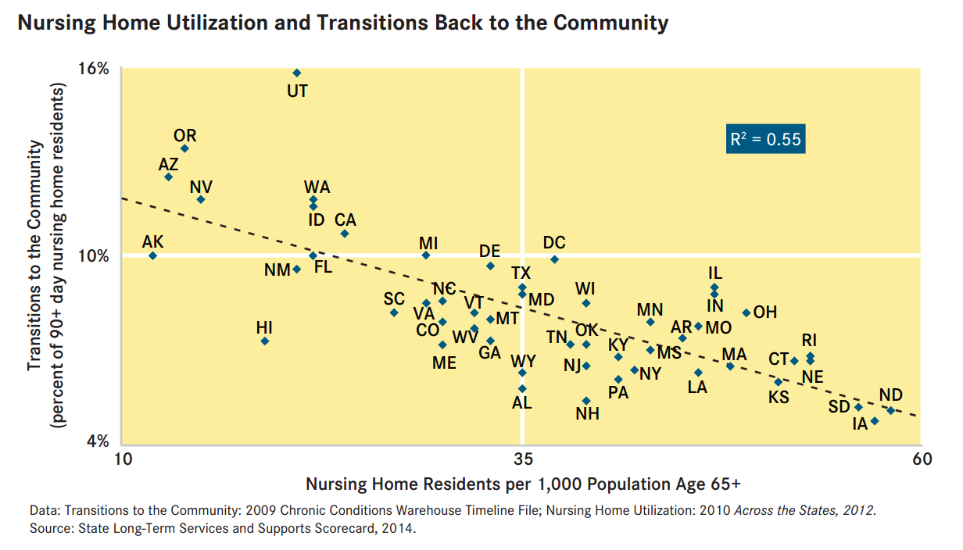
Transitions back to the Community Strongly Correlated with Low Nursing Home Use
:

Slide 16
Importance of Aging and Disability Resource Centers
Aging and Disability Resource Center Functions (Composite Indicator, scale 0-70) | -0.773
Nursing Facility Population/Persons aged 65+

Slide 17
Cost and Income’s Broad Effects
Percent Below Poverty Level Age 18+
Correlated with | Correlations
30 Hours/Week of Home Care | -0.725
Percent of Nursing Home Residents with Moderate to Severe Dementia with One or More Potentially Burdensome Transitions at End of Life | 0.659

Slide 18
Pressure Sores Make a Difference
Percent of High-Risk Nursing Home Residents with Pressure Sores
Correlated with | Correlations
Percent of Long-Stay Nursing Home Residents Hospitalized within a Six-Month Period | 0.648
Percent of Nursing Home Residents with Moderate to Severe Dementia with One or More Potentially Burdensome Transitions at End of Life | 0.741

Slide 19
Access to Housing Alternatives
Assisted Living and Residential Care Units per 1,000 Population Age 65+
Correlated with | Correlations
Percent of Long-Stay Nursing Home Residents Hospitalized within a Six-Month Period | -0.605
Percent of Medicaid Aged or with Disabilities LTSS Users First Receiving Services in the Community | 0.336
30 Hours/Week of Home Care | 0.453

Slide 20
Take Aways - Summary
Six-variable model accounts for 82% of variance in the state NF Medicaid Occupancy %
Four-variable model accounts for 67% of variance in state NF Population/number of Persons Age 75+
AARP new Effective Transitions Dimension has internal coherence;
Aging and Disability Resource Centers have an Impact;
Cost of services and household Income have broad effect;
Pressure Sores make a Difference, as does
Access to Housing Alternatives instead of NF bed

Slide 21
References
AARP Rising Expectations 2014 http://www.aarp.org/home-family/caregiving/info-2014/raising-expectations-2014-AARP-ppi-health.html
Weiner et. al. Why nursing home utilization rates are declining, http://nasuad.org/sites/nasuad/files/hcbs/files/160/7990/SCGNursing.pdf
Hendrickson and Kyzr-Sheeley Determining Nursing Home Eligibility, http://nasuad.org/sites/nasuad/files/hcbs/files/137/6814/Nursing_Facility_Level_of_Care_FINAL.pdf

Slide 22
Contact Information
Leslie.c.hendrickson@gmail.com
For copy of Presentation go to http://hendrickson-consulting.com/publications/

Slide 23
A Footnote on Specification in Model Building
Strictly speaking this presentation focuses more on the “specification” of variables than the construction of a model.
Specification is the precursor to model building wherein potential variables are examined for their possible inclusion in a model.
The text of this presentation refers to “models” because it is an easier concept to explain.

