Slide 1
Washington State Behavioral Health System Assessment Final Recommendations
November 22, 2016

Slide 2
Agenda
PCG Overview and Scope of Work
Review of Initial Findings
Stakeholder Visioning and Recommendations Evaluation Approach
Recommendations

Slide 3
Public Consulting Group (PCG) Overview
PCG is a management consulting firm helping state, county, and other municipal governments achieve their performance goals and better serve populations in need through industry-leading consulting, operations, and technology solutions
More than 30 years of experience serving the public sector
Extensive experience in all 50 states, clients in six Canadian provinces, and a growing practice in the European Union

Slide 4
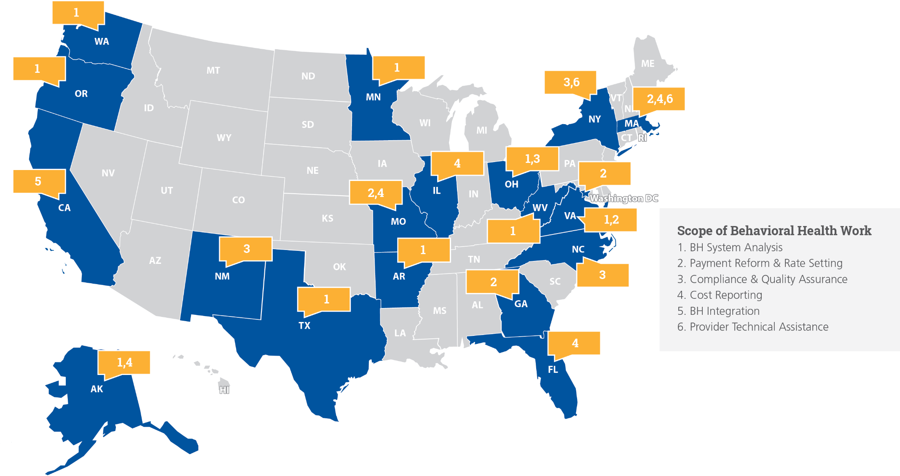
PCG Behavioral Health Experience
PCG has notable experience in Behavioral Health consulting working with agencies across the country.

Slide 5
PCG Scope of Work
PCG is contracted to examine the current configuration and financing of the state hospital system and make recommendations in several areas as directed in Engrossed Substitute Senate Bill 6656.
CONTRACT DELIVERABLES
The Final Recommendations Report has been submitted to OFM for review.
The report is in a draft format and is currently in the review process.
The report provides nine major recommendations.
These recommendations are the result of a stakeholder visioning process. Stakeholders helped to develop and vet recommendations presented by PCG.
Initial Findings Report
Final Recommendations Report
Implementation & Communications Plan

Slide 6
Review of Initial Findings

Slide 7
Review of Initial Findings
Major Findings:
State hospital utilization and operations face a number of challenges.
Community based resources exist in a disparate set of systems that does not effectively support complex patient needs.
Ambiguity and lack of system-wide standardization weakens the ability of providers, BHOs, and patients alike to effectively use the system.
Best practices for mental health funding are incentivizing reduced institutionalization and increased outcomes-oriented community care.
Key Challenges Identified:
the volume of patients committed to the state hospital and subsequent admission delays
discharge delays for patients who no longer require state hospitalization
availability of specialized residential and other community programs
coordination across the care continuum

Slide 8
Stakeholder Visioning and Recommendations Evaluation Approach

Slide 9
Stakeholder Sessions
For the recommendations report, PCG captured stakeholder feedback through two major avenues:
Visioning Sessions
Conducted in-person among groups including representatives from:
Department of Social and Health Services
Health Care Authority
Service Employees International Union
Union of Professional Workers
Washington Federation of State Employees
One-on-one interviews
Conducted with stakeholders not available to attend group visioning sessions within the specified time frame. PCG conducted one-on-one interviews with:
4 community health providers
4 SCQISH Committee members

Slide 10
Visioning Sessions
The Visioning Sessions provided a systematic way for participants to collaborate and identify common themes in improving the behavioral health system.
The Exercise:
Imagine a highly effective, fully integrated behavioral health system in the year 2020.
Identify the action steps taken by the state between now and then to realize that vision.
Visioning Approach
The Process:
Participants considered action items individually and then brainstormed with others.
All identified action steps and components of a highly effective system were posted for all to review and discuss.
Participants were asked to group the recommendations into discrete categories.

Slide 11
Visioning Sessions
The outcome of the collective visioning sessions was the identification of six areas of improvement:
6. Establish a robust continuum of care and support for transitions.
1. Refine the role of state hospitals to serve the right patients in the right environment.
6. Continuum of
Care
Role of State
Hospitals
5. Increase focus on outcomes to ensure the system delivers desired results and continuous improvement.
6 Areas of
Improvement
2. Improve early identification and treatment of behavioral health needs.
5. Outcomes
Focus
2. Early
Identification
4. Support workforce development efforts and use of best practices to attract and retain staff.
4. Workforce Development
3. Collaboration & System Redesign
3. Increase collaboration and redesign system to achieve patient centered care.

Slide 12
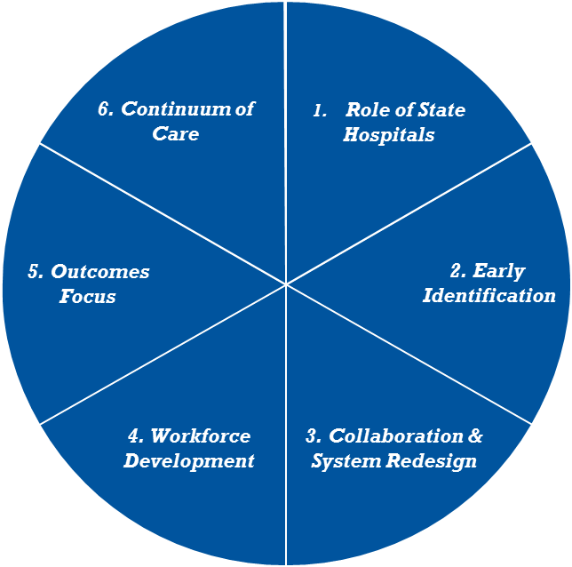
Evaluation Criteria
Building on the Areas of Opportunity, PCG developed a set of evaluation criteria. Proposed recommendations were assessed against these criteria.
Evaluation Criteria
Recommendation Selected for inclusion in Final Report
6 Areas of Improvement
Improve Efficiency/Effectiveness of Behavioral Health System
Facilitate Community Supports and Limit Use
of State Hospitals
Focus on Patient Centered, Recovery Oriented Care
Ease of Implementation
Realized Savings to Offset Cost

Slide 13
Recommendations

Slide 14
Recommendations
Recommendation #1
Require the Director of the Health Care Authority to submit a state psychiatric hospital managed care risk model to the Governor and the Legislature by October 1, 2017 to support putting Medicaid managed care organizations at risk for this benefit effective January 1, 2020.

Slide 15
Recommendations
Recommendation #1
Prepare state agencies and managed care organizations to implement full integration
Align financial structure with goal of reducing inpatient utilization
Benefits
Increase collaboration and redesign system to achieve patient centered care
Refine the role of state hospitals to serve the right patients in the right environment
Support workforce development efforts and use of best practices to attract and retain staff
Areas of Opportunity

Slide 16
Recommendations
Recommendation #1
Time Frame
Twelve months to design the risk model. In follow up, use 2018 to develop risk model features and 2019 to implement for effective launch 1/1/20
State psychiatric hospital business model lacks readiness for managed care
Undefined legal role of a business entity in managing a civil commitment
Undeveloped MCO contract provisions and performance metrics that permit the framework of the model to be understood by MCOs and hospitals
Key Considerations

Slide 17
Recommendations
Recommendation #1
Key Points
Outcomes
HCA, in coordination with DSHS, must draft a risk model “blueprint” to demonstrate that the concept can successfully be made operational
The transition time in the next three years is optimally used to design, develop and implement the appropriate risk model
Addresses the need for accountability and risk management for hospital bed use by non-Medicaid populations and Medicaid enrollees not enrolled in managed care
Promotes value based purchasing
Encourages competition based on cost and quality among hospitals
Promotes improved health care outcomes through financial incentives
Promotes full integration of physical and behavioral health in 2020

Slide 18
Recommendations
Recommendation #2
Establish a new unit within the Office of Financial Management (OFM) that integrates and coordinates fiscal analysis of all behavioral health services across agencies and units of government.

Slide 19
Recommendations
Recommendation #2
Supplements and does not replace existing agency-based budget oversight
With behavioral health initiatives increasingly stretching across agencies and state and local governments, this unit provides a singular focus on “connecting the dots”
Assures synergies of agency budget initiatives so that each initiative is “greater than the sum of its parts”
Benefits
Increase collaboration and redesign system to achieve patient centered care
Refine the role of state hospitals to serve the right patients in the right environment
Areas of Opportunity

Slide 20
Recommendations
Recommendation #2
Time Frame
Staff the unit and positions by Spring 2017
Individuals with the knowledge and experience to manage a complex unit/division of state government
An estimated 6 new positions would be required, reflecting the following FTE roles: 1 director, 2 HCA analysts, 1 DSHS analyst, and up to 2 FTEs of additional analyst support
Key Considerations

Slide 21
Recommendations
Recommendation #2
County Behavioral Health Funding
The state does not have ultimate authority over county budgets.
Important the state has a general understanding of the types of services that each county funds with their dollars.
Medicaid Services in Hospital and Community Settings
Plan for IMD reductions by developing offsetting strategies that will maximize state reimbursement.
Focus on State Operational changes, Non State Hospital Alternatives, and Community Based Alternatives.
Integrated Financial
Analysis Unit
Non Medicaid DSHS Funding
DSHS BHA is responsible
for over a budget of over $1.1 billion in the
2015-17 biennium.
Important the state has detailed understanding of what these funds finance and how those services relate to other behavioral health spending in the state.
Medicaid Delivery System Reform Incentive Program Planning
CMS approved $1.5 billion investment over the next 5 years to transform Medicaid in Washington
Highlights of the framework include a project for “Bi-directional Integration of Care” and “Care Transitions” for those in need of supportive housing.
Medicaid Value Based Purchasing Planning
Healthier Washington established a goal of tying 90% of state payments to value by 2019.
Washington’s behavioral health leadership must ensure that they are invested in the VBP discussion.

Slide 22
Recommendations
Recommendation #3
Enhance community support by strengthening subacute care episode management and community services to reduce admissions to state psychiatric hospitals.
Specifically, this will be done by funding 3 new mobile crisis teams, 2 new crisis walk in centers, a 15% increase in the number of peer support specialists and the commencement of a grant program to enhance substance use disorder treatment more broadly into mental health care.

Slide 23
Recommendations
Recommendation #3
Increases access for consumers at risk of destabilization to receive timely interventions
Increases the likelihood that consumers will be served by professionals familiar with them and/or their conditions in their own communities
Encourages greater collaboration among mental health professionals in a community
Better addresses the significant need for integrated treatment of mental health and substance use disorder issues
Benefits
Improve early identification and treatment of behavioral health needs
Increase collaboration and redesign system to achieve patient centered care
Establish a robust continuum of care and support for transitions
Increase workforce development and use of best practices to attract and retain staff
Areas of Opportunity

Slide 24
Recommendations
Recommendation #3
Time Frame
One to two years
Communities may struggle to provide the requisite number and type of professionals to adequately staff teams and facilities
In rural areas of the state, timely intervention may be hindered by distance
Crisis walk-in centers do not currently exist in the state
Key Considerations

Slide 25
Recommendations
Recommendation #3
1. Continue to expand and refine the use of mobile crisis teams in additional regions of the state, regularly assessing impact on reducing psychiatric hospitalizations and diverting from jails.
z
3. Fully integrate substance use disorder (SUD) and mental health disorder treatment, including increased funding for peer specialists.
Community Services & Supports
2. Implement crisis walk-in centers in high need, urban areas. Identification of areas for placement of crisis walk-in centers and mobile crisis teams should be coordinated so as to maximize coverage and avoid potential duplication of crisis services.

Slide 26
Recommendations
Recommendation #4
Establish community bed capacity for civil commitments and transitional acute psychiatric care needs to promote regional care and the potential for an emphasis on specialty care for co-morbid conditions.

Slide 27
Recommendations
Recommendation #4
Allows the existing state hospitals to establish forensic centers of excellence to better treat forensic patients and focus more on hard to serve civil patients
Enables more patients to be treated close to their home communities and support systems
Creates facilities designed to address the particular needs of a region or particular co-occurring conditions
Allows for capture of Medicaid funding to offset state costs
Benefits
Refining the role of state hospitals to serve the right patients in the right environment
Increase collaboration and redesign system to achieve patient centered care
Areas of Opportunity

Slide 28
Recommendations
Recommendation #4
Time Frame
Three to five years
Need for capital funding and processes to support the design and development of new facilities
Review of existing community capacity and plan to accommodate population
Adjustments to the orders issued by the Involuntary Treatment Act (ITA) Courts to allow greater placement flexibility
Key Considerations

Slide 29
Recommendations
Recommendation #4
Establishing community bed capacity will allow Washington to provide acute psychiatric inpatient care in regional settings
These smaller facilities would be recovery focused and typically handle shorter lengths of stay
A subcategory of this recommendation, PCG suggests that Washington consider a 45-day commitment term for civil patients who have completed a 14-day stay but require additional inpatient care prior to discharge

Slide 30
Recommendations
Recommendation #5
Reform state hospital programming to more broadly include substance use disorder integration and peer support.

Slide 31
Recommendations
Recommendation #5
Improved outcomes for comorbid patients
Reduced risk of readmission and recidivism post discharge
Reduced length of stay for inpatient treatment
Benefits
Increase collaboration and redesign system to achieve patient centered care
Increase workforce development and use of best practices to attract and retain staff
Areas of Opportunity

Slide 32
Recommendations
Recommendation #5
Time Frame
18-month implementation and initial evaluation
Expanding more multi-disciplinary teams
More staff training on co-occurring disorder treatment
Community placement for individuals with co-disorder issues
Key Considerations

Slide 33
Recommendations
Recommendation #5
Integration
Align state hospital treatment protocols with the significant body of research supporting consistent and specific integration of substance use disorder and mental health treatment
Integration aims to treat substance use disorder in the context of the patient’s mental health and other behavioral disorders, using treatment modalities
Peer Support
Monitoring
Metrics related to discharges, community placements and long term placement/ readmission data should be evaluated over time
Pilot Program
Place peers within the state hospitals to support patient needs well before the time of discharge and ideally close to the time of admission
Initial Phase
Fund 11 peers at Western State Hospital and 4 at Eastern State Hospital, serving 15 percent of the current patient population

Slide 34
Recommendations
Recommendation #6
Align community mental health placements with identified civil placement discharge needs by:
Establishing a transitional, statewide supportive housing benefit administrator
2) Creating a temporary Office of Behavioral Health Housing Initiatives, charged with facilitating the collaboration of capacity building investment pools
3) Establishing expanded responsibility for selected state hospital transitions and management practices to ALTSA and DDA.

Slide 35
Recommendations
Recommendation #6
Alleviates discharge bottlenecks by aligning community resources with housing needs
Facilitates the success of supportive housing integration with managed care in 2020
Assures capacity building investment funds complement each other to achieve statewide service and facility needs
Strengthens responsibility for the treatment management of persons with developmental disabilities
Benefits
Increase collaboration and redesign system to achieve patient centered care
Establish a robust continuum of care and support for transitions
Areas of Opportunity

Slide 36
Recommendations
Recommendation #6
Implement benefit administrator 7/1/17
Create Office of Behavioral Health Housing Initiatives 1/1/17
18 months to expand ALTSA and DDA responsibility
Time Frame
Bridges gaps in development of supportive housing provider capacity and benefit development
Bridges gaps in disparate capacity-building investment funds
Responsibilities of two state entities (ALTSA and DDA) must be adjusted
Key Considerations

Slide 37
Recommendations
Recommendation #6
1. Create a transitional, Statewide Supportive Housing Benefit Administration
Temporary assignment of this benefit to a third party administrator will eventually assure the success of MCO-led supportive housing in 2020
2. Create a Temporary Office of Behavioral Health Housing Initiatives
Aim would be to provide a point of reference and set of benchmarks that permit these separate initiatives to be greater than the sum of their parts through a coordinated development effort
Alignment of community mental health placements with identified civil placement discharge
3. ALTSA should assume expanded responsibility, but not financial risk, for helping their clients transition from the state hospitals
Directly addresses the discharge delays of multi-agency clients to improve the flow of patients through the hospitals
Increased coordination/funding needed for individuals not meeting the nursing facility level of care.
4. DDA should expand responsibility for individuals with intellectual and developmental disabilities (ID/DD) who are in the state hospitals.
Directly addresses the discharge delays to improve the flow of patients through the hospitals
Funding to follow individuals into community placements

Slide 38
Recommendations
Recommendation #7
Develop new, regional care coordination models to follow rising risk and high risk patients throughout the care continuum, including those with significant mental health and substance use disorder needs.

Slide 39
Recommendations
Recommendation #7
Supports and monitors higher risk patients to promote compliance with the treatment plan and prevent escalation
Reduces length of stay in inpatient settings for higher risk populations
Facilitates better coordination among agencies when multiple entities are engaged in providing care and supports to address a range of patient needs
Provides additional support for meeting the state’s 2020 mandate for full integration
Benefits
Establish a robust continuum of care and support for transitions
Increase collaboration and redesign system to achieve patient centered care
Areas of Opportunity

Slide 40
Recommendations
Recommendation #7
Time Frame
All components of the recommendation implemented within 18 months
A system to accurately track target individuals in real time will be required
BHO contract language must be updated
Key Considerations

Slide 41
Recommendations
Recommendation #7
Direct BHOs to use reserve funding to implement a modified health home program that identifies and supports rising risk and high risk patients.
Requires BHOs to establish a program that is consistent with some features of a health home
Designated Care Manager
Implement a “light” health home model to lay the foundation for transition to full integration in 2020
Continuum of Care

Slide 42
Recommendations
Recommendation #8
Invest in transitional care reform initiative to add step-up, step-down and HARPS resources. Specifically, add two new, 10-bed step down facilities in Western Washington and one new 10-bed step down facility in Eastern Washington.

Slide 43
Recommendations
Recommendation #8
Prevents initial hospitalization
Prevents readmission
Allows individuals ready for discharge, particularly at Western State Hospital, to find timely community residential placement
Makes state hospital beds available for individuals in need of inpatient psychiatric care awaiting placement
Benefits
Improve early identification and treatment of behavioral health needs
Increase collaboration and redesign system to achieve patient centered care
Areas of Opportunity

Slide 44
Recommendations
Recommendation #8
Time Frame
Two years to build facilities and implement programs
Statutory limitations on voluntary admission
Voluntary bed capacity
Treatment protocols
Will require extension of Residential Support Waiver to continue receiving federal match beyond 2019
Dependent on identification of suitable providers through Request for Proposal process
Key Considerations

Slide 45
Recommendations
Recommendation #8
State Hospital
Less restrictive option for those in need of a less acute level of care but who may not be ready for discharge
Step-Up Program
Step-Down Program
Short-term inpatient care, mitigating the potential for escalation and preventing commitment
Use of voluntary commitment beds in community hospitals in addition to new construction
Adapt the model used to develop ESF facilities to also develop step-down capacity
Determine whether other step-down services may be attached to an existing service facility such as a residential treatment facility or freestanding E&T
Less restrictive option for those in need of a less acute level of care to remain in the community
Housing and Recovery through Peer Services (HARPS)
Continue to incrementally increase the number of HARPS teams each year so an additional 100 individuals may be assisted

Slide 46
Recommendations
Recommendation #9
Create an integrative technology infrastructure to support behavioral health service delivery.

Slide 47
Recommendations
Recommendation #9
Links key agencies, caregivers, and patients to a common information platform
Increases the volume and accuracy of information exchanges among behavioral health providers
Provides the technology environment to support a Learning Health system
Benefits
Early identification and treatment of behavioral health needs
Effective tracking and use of data for system improvement
Areas of Opportunity

Slide 48
Recommendations
Recommendation #9
After a 6 to 12-month period of creating specifications, programming a system generally takes 2-3 years as capabilities are sequentially added in tiers
Time Frame
Knowledge gap amongst providers and state staff as they are not universally familiar with using a similar IT system
Lack of current system means there isn’t much background from which to draw for system design elements
Key Considerations

Slide 49
Recommendations
Recommendation #9
Multiple states have developed technology platforms linking major service delivery programs. Washington can follow best practices from these systems.
Incorporate electronic health information as part of the data contained in the system.
Build a learning health system that uses health information to drive decision making and increase effective health care practices.
Linked technology platform
Electronic Health Records
Integrative technology infrastructure
Behavioral Health Assessment Tool
A missing component in Washington’s behavioral health system is a behavioral health assessment tool similar to the Comprehensive Assessment Reporting Evaluation (CARE) tool used by ALTSA.

